Slide 1
Movie Recommendation System
Eva Burns
05/25/2023

Slide 2
Table of contents
01
04
02
03
07
Problem Statement
Results and Learnings
Feature Engineering & Transformations
05
08
Assumptions
/Hypotheses
Proposed Approach
Future Work
06
EDA
Proposed Solution

Slide 3
Problem Statement
Everyone has encountered this problem before: you sit down to watch a movie, have no idea what to watch or what you think you would like.
I will create a recommendation system using 26 million ratings from 270,000 users.
This will be done by predicting what the user will rate each movie and recommending the highest predicted rated movies.

Slide 4
Data Description
The dataset was found at The Movies Dataset on Kaggle
Movies Metadata
Ratings
Contains information on 45,000 movies found on TMDB.
Relevant features include id, title, genres, popularity, vote_average, and vote_count
26 million ratings from 270,000 users for 45,000 movies
Ratings are from 0.5 to 5, with 5 being the best

Slide 5
Assumptions/Hypotheses about data and model
Because ratings are user inputted, there are biases involved in the data
There are certain groups of people who may leave ratings on movies:
Critics
People who feel very strongly about the movie (both positively and negatively)
For the purposes of this project, I will assume that the ratings are representative of the general population

Slide 6
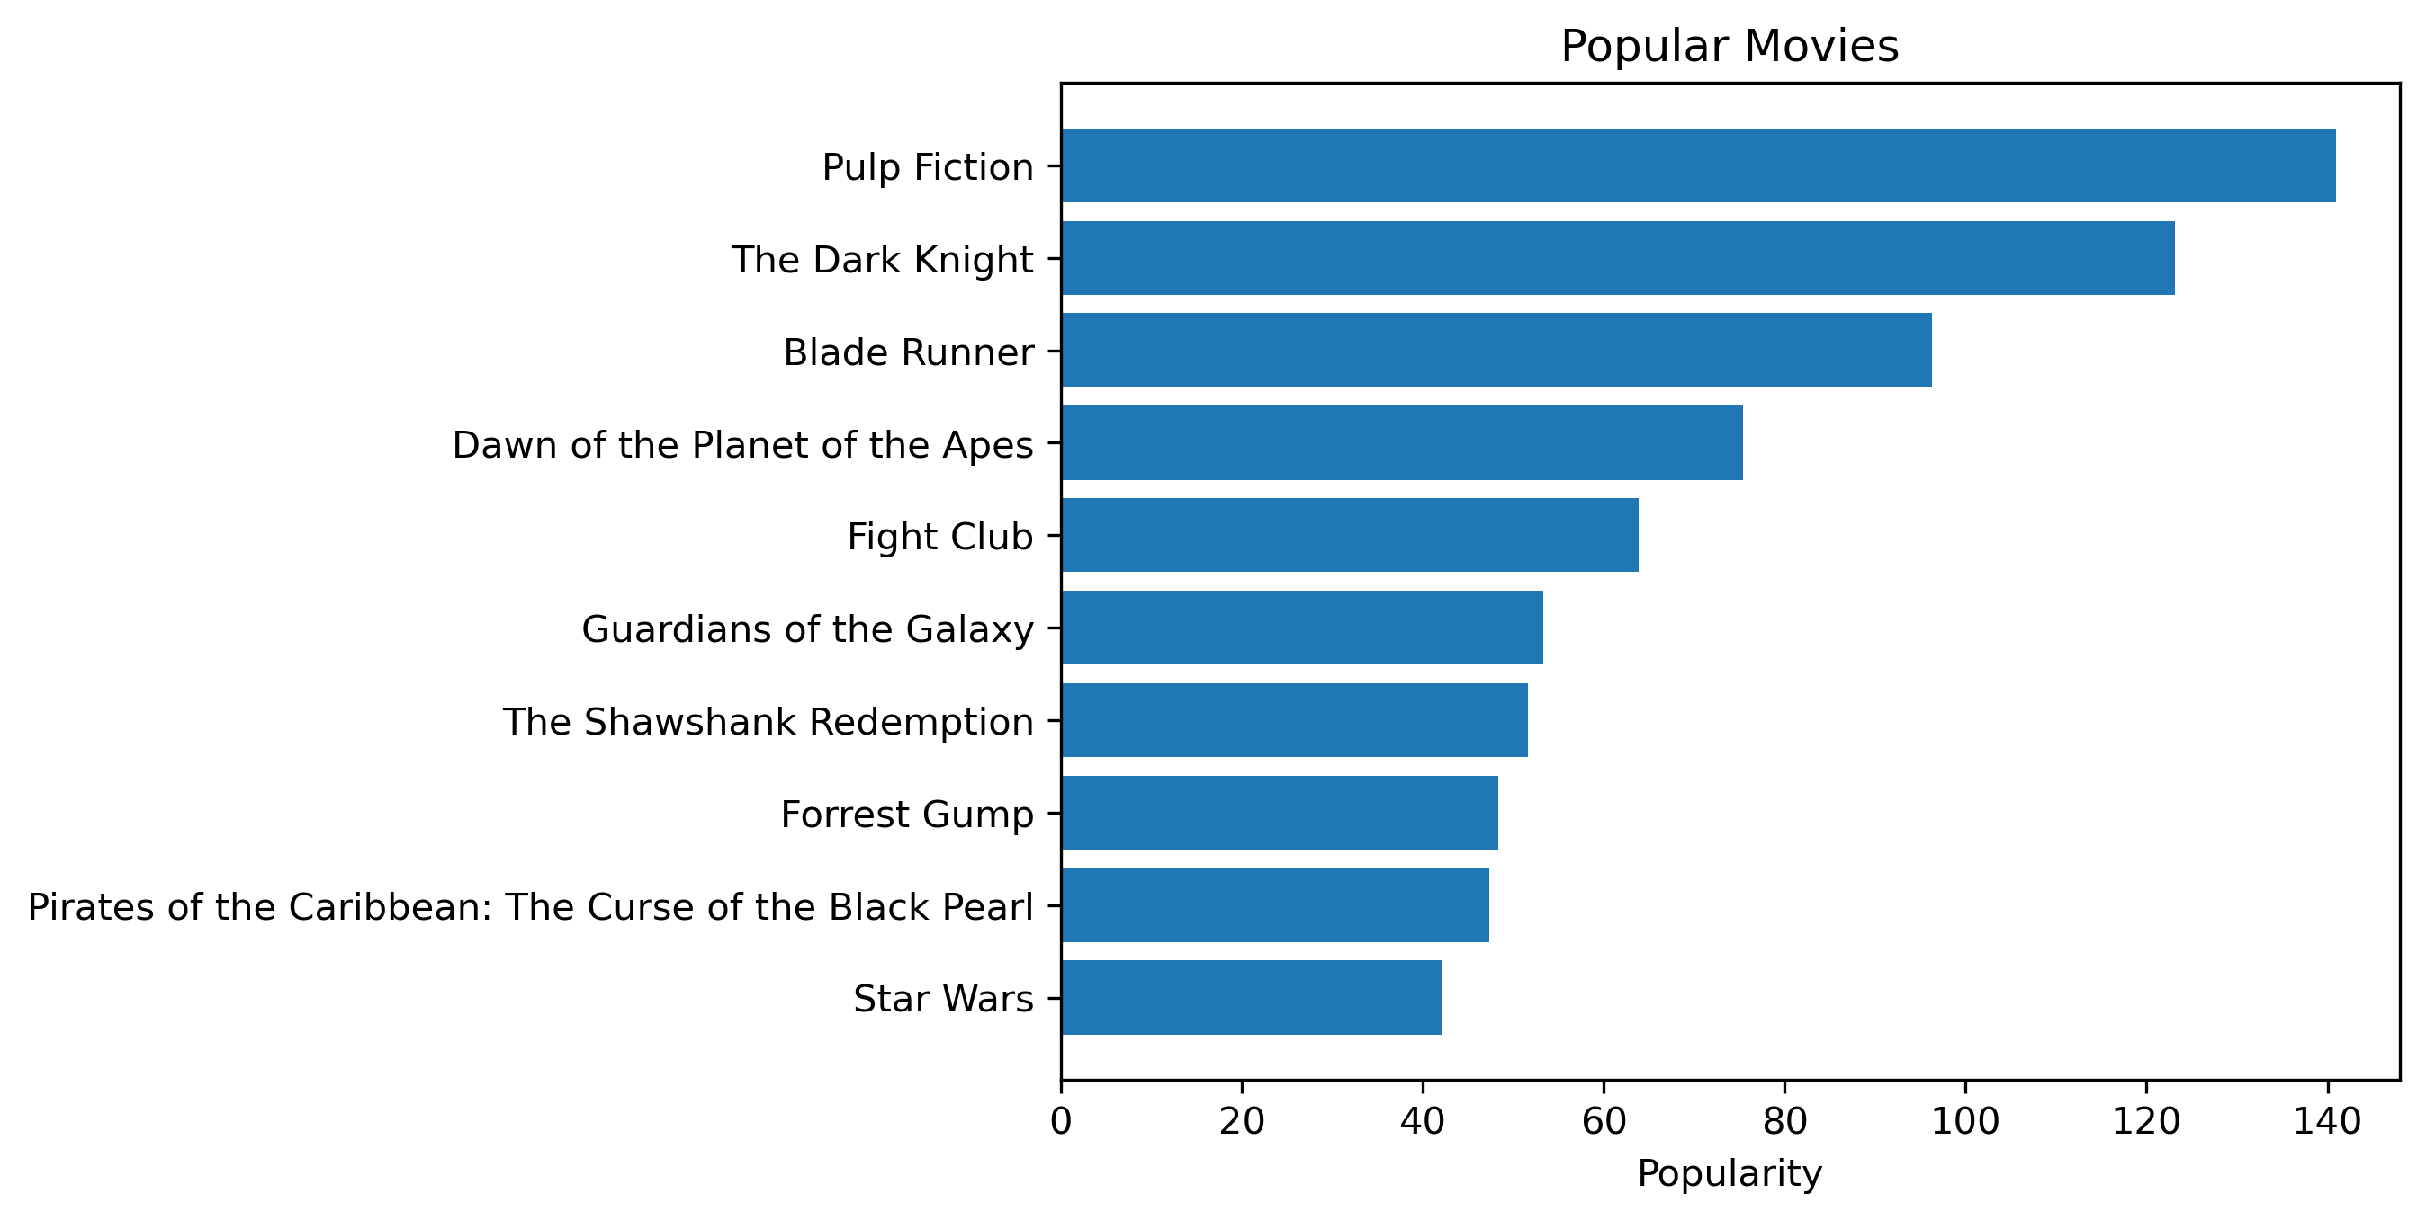
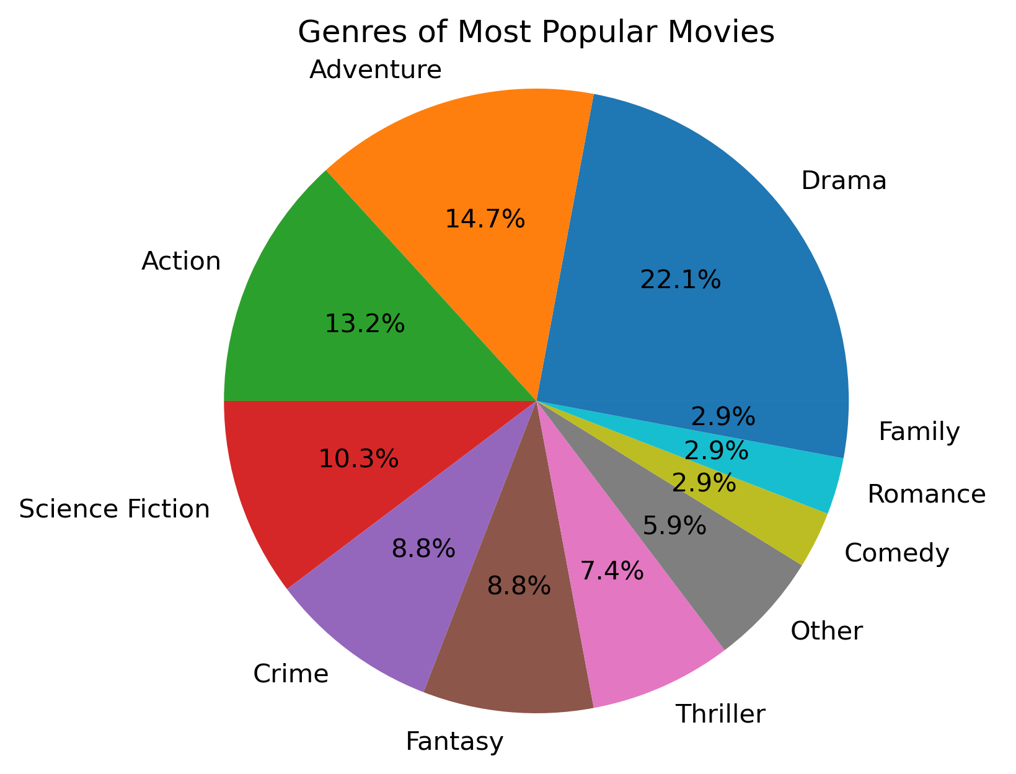
Exploratory Data Analysis – Film Popularity
Most popular movies were found using IMDB’s popularity metric

Slide 7
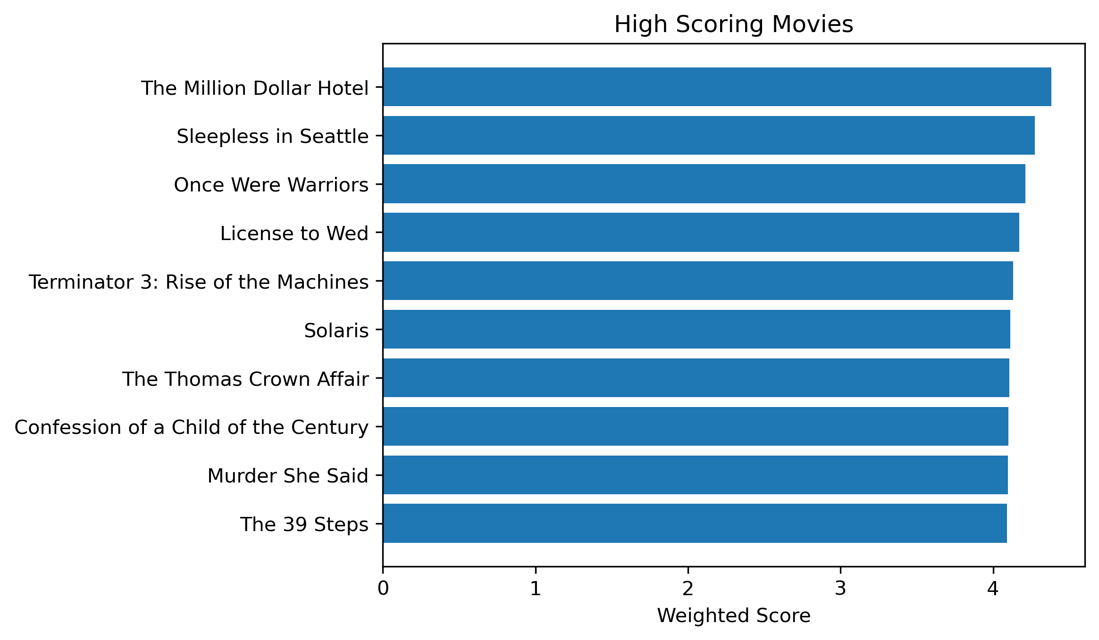
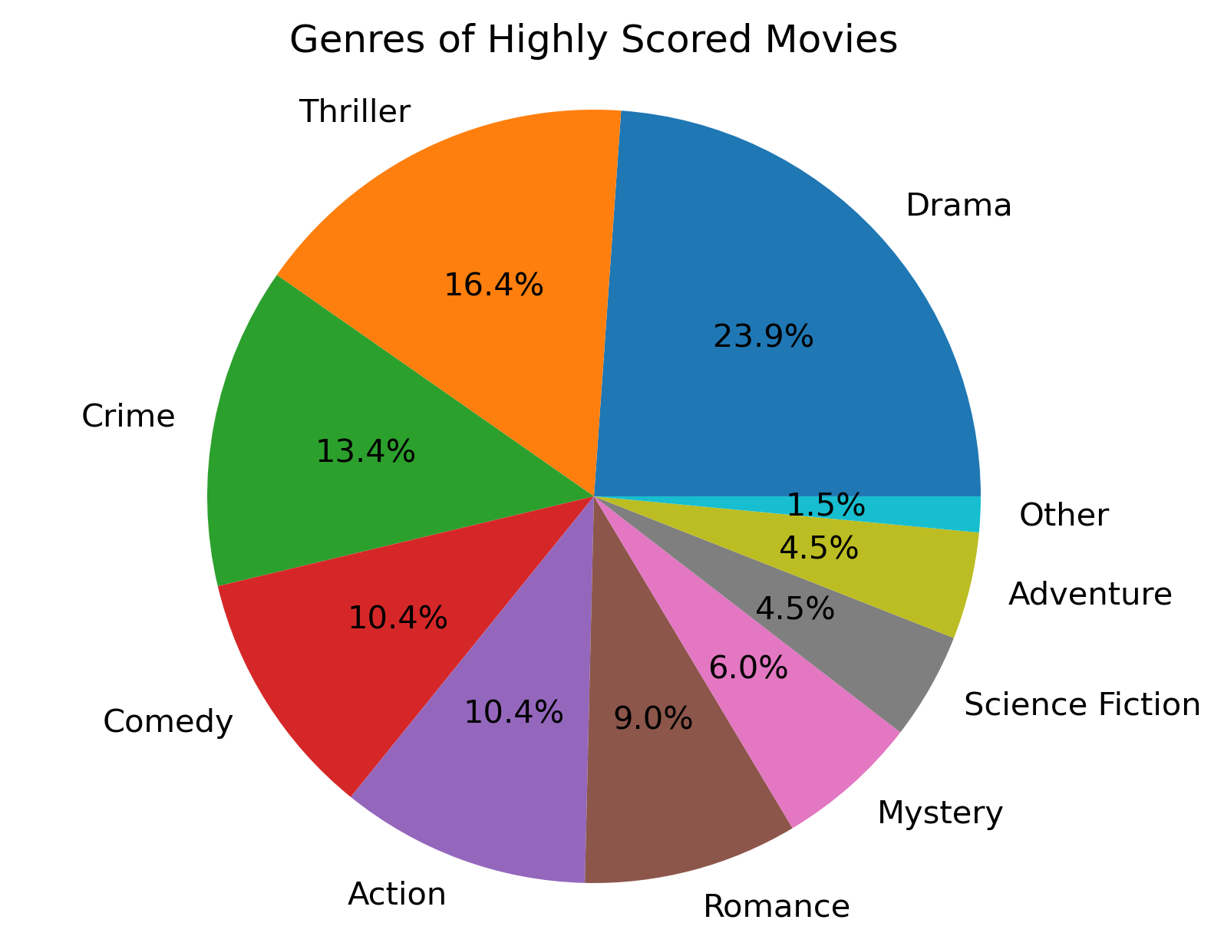
Exploratory Data Analysis – Ratings
Weighted rating was calculated using a formula from IMDB:
v - number of ratings for movie, m - minimum ratings required to be listed, R - average rating of movie, C - mean rating across the whole report

Slide 8
Feature Engineering & Transformations
Convert the ratings data into a readable format for the model I will use which I will explain on the next slide.
The functions needed for the transformation comes from the Surprise package where the data is converted to a list of tuples
For example, here are the first ten rows of the ratings dataset converted:
[(1, 110, 1.0, None),
(1, 147, 4.5, None),
(1, 858, 5.0, None),
(1, 1221, 5.0, None),
(1, 1246, 5.0, None),
(1, 1968, 4.0, None),
(1, 2762, 4.5, None),
(1, 2918, 5.0, None),
(1, 2959, 4.0, None),
(1, 4226, 4.0, None)]
It is ordered by (userId, movieId, rating)

Slide 9
Proposed Approach
I first thought about using Collaborative Filtering, but it has some limitations:
Scalability - computational demands increase as the number of users and movies grows
Sparsity - similarity between two seemingly dissimilar movies might be remarkably high due to a single user who ranked them both similarly
I decided on the Singular Value Decomposition (SVD) model found in the Surprise package in python
Reduce the dimensionality of the utility matrix by extracting its latent factors (ratings)
Map each user and movie onto a latent space with a dimension of ‘r’
Facilitates a more meaningful understanding of the relationship between users and movies, making them directly comparable

Slide 10
Proposed Solution
Build SVD model, employing a cross validation of 5 folds, using RMSE and MAE as accuracy metrics
The model predicts what a specific user will rate a specific movie
To make recommendations for a specific user:
Predict a rating for every movie for the user
Sort the predicted ratings to get movies with top predicted ratings
Recommend top rated movies
* Note movies already rated by user will be excluded from recommendation

Slide 11

Results (Accuracy)
RMSE - 0.7031
MSE - 0.4943
MAE - 0.5338

Slide 12
Results – Example Recommendation
This is an example of User 1’s recommendation based on their past ratings
Movie | Rating
Sleepless in Seattle | 5.0
Rocky Balboa | 5.0
Caesar Must Die | 5.0
The 400 Blows | 4.5
Young and Innocent | 4.5
Fools Rush In | 4.0
License to Wed | 4.0
Shriek If You Know What I Did… | 4.0
Confession of a Child of the Century | 4.0
The Mystery of Chess Boxing | 3.5
Three Colors: Red | 1.0
Movie | Pred. Rating
Beverly Hills Cop III | 5.000000
A Woman, a Gun and a Noodle... | 4.904216
Rome, Open City | 4.895459
Apocalypse Now | 4.848280
The Dark | 4.840669
Zatoichi | 4.793591
While You Were Sleeping | 4.784361
We're No Angels | 4.777725
Hard Target | 4.757174
Red River | 4.756867

Slide 13
Future Work
A hybrid recommender incorporating the SVD model with some movie content information
Based on the movies the user gave a high rating for, find movies that other users also liked
Then, find movies that have similar plots, cast, or genre to the movies the user already liked and combine into single recommender
Also, the highest recommended movie for User 1 was a sequel. User 1 has not seen the original movie, so it does not make sense to recommend that movie. An adjustment to the recommender should be made to filter out sequels if the user has not seen the movies before it

